Slide 1
Unsupervised Learning with NLP to Extract Similarities between Terms of Services
Andrew Haverly

Slide 2
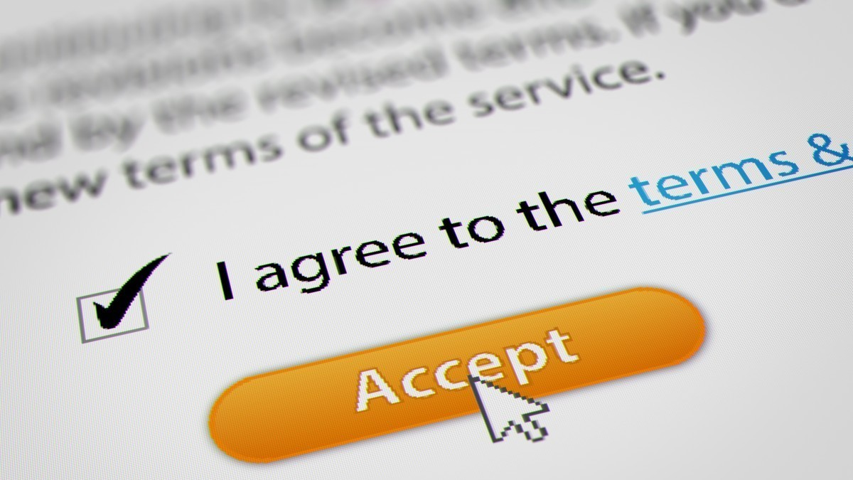
What is the Problem?
Terms of Service agreements (ToS) are too long
Therefore, no one is reading them
Is there a way to automatically parse them to indicate the severity of the restrictions and permissions?
[1]

Slide 3
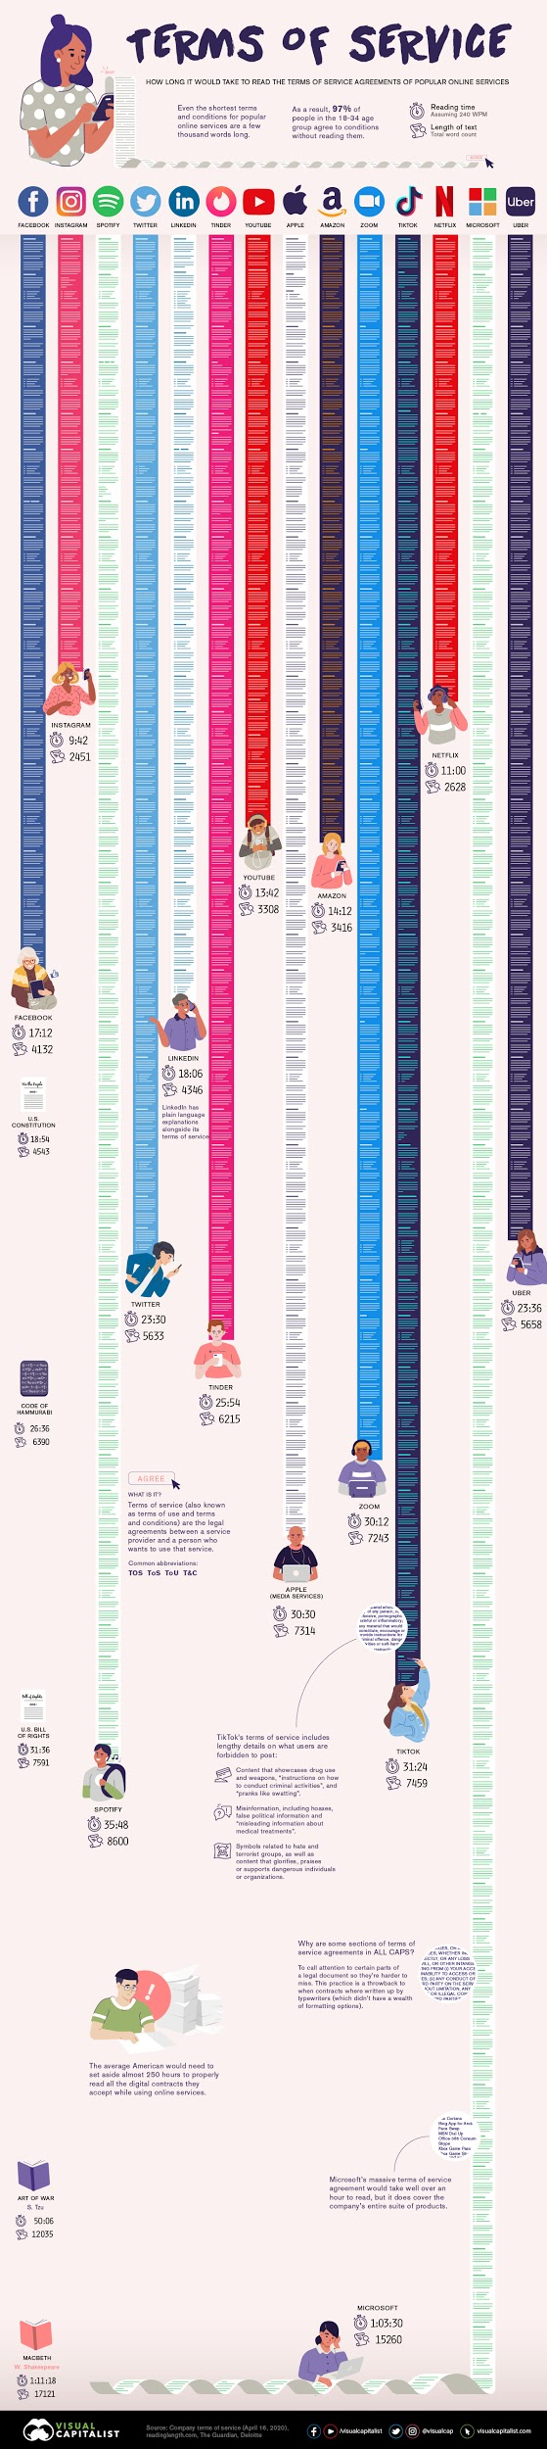
How Long* are Common Terms of Service Agreements?
* Assuming average of 240 WPM
Facebook | Instagram | Spotify | Twitter | LinkedIn | Tinder | YouTube
17:12 | 9:42 | 35:48 | 23:30 | 18:06 | 25:54 | 13:42
Apple | Amazon | Zoom | TikTok | Netflix | Microsoft | Uber
30:30 | 14:12 | 30:12 | 31:24 | 11:00 | 1:03:30 | 23:36
The average American would need to spend 250 hours to properly read all of the agreements they accept for their online activities [2]
https://www.visualcapitalist.com/terms-of-service-visualizing-the-length-of-internet-agreements/

Slide 4
Why is this Important?
Facts:
Legal contracts are binding, even if the user does not read the contract [3]
Drafters are incentivised to include unfair terms [3]
Only 1 percent of users read the ToS [4]
ToS can often be changed at any time without notice to the user [5]
There are very few restrictions on the terms in these agreements [6]
Implications:
Very few people are reading legally binding agreements
These agreements can contain virtually any terms

Slide 5
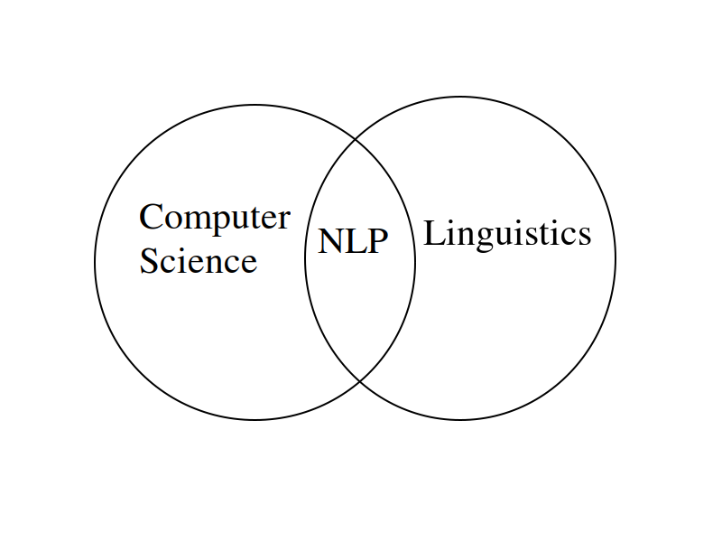
How Can the Problem Benefit from Machine Learning?
There is no feasible way to teach a machine how to understand ToS
However, a machine might be able to learn how to convey the contents to a user using natural language processing (NLP)
NLP is the bridge between computer science and linguistics

Slide 6
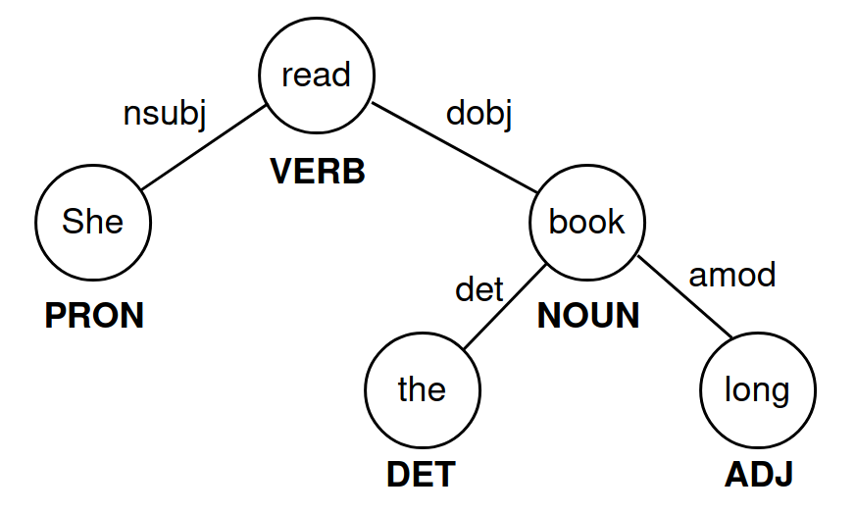
Approach
Use NLP to create feature vectors for every ToS the user is familiar with
Tokenization
Lemmatization
N-grams
Term frequency-inverse document frequency (TF-IDF)
Part of Speech (PoS) tagging
Named Entity recognition
Parse trees
She read the long book.

Slide 7
Approach (continued)
2. Apply an unsupervised clustering algorithm
K-means (k=1 or more)
Latent Dirichlet Allocation
Etc.
3. The clustering algorithm is used to sort the new ToS relative to the familiar ToS
Output either a single familiar ToS or a few familiar ToS
K-means illustration

Slide 8
Works Cited
[1] Goldstein, Jacob, and Alexi Horowitz-Ghazi. “Terms Of Service.” NPR, NPR, 5 Mar. 2020,
www.npr.org/2020/03/04/812264543/episode-976-terms-of-service.
[2] LePan, Nicholas. “Visualizing the Length of the Fine Print, for 14 Popular Apps.” Visual Capitalist, 25 Jan. 2021,
www.visualcapitalist.com/terms-of-service-visualizing-the-length-of-internet-agreements/.
[3] “Can You Be Held Responsible for an Agreement Without Reading It?” New York Business Law RSS,
nylawblog.com/2013/08/can-you-be-held-responsible-for-an-agreement-without-reading-it/.
[4] “Report Finds Only 1 Percent Reads 'Terms & Conditions'.” Digital Journal: A Global Digital Media Network, 29 Jan. 2020,
www.digitaljournal.com/business/report-finds-only-1-percent-reads-terms-conditions/article/566127.
[5] “Frontpage · ToS;DR.” Terms of Service; Didn't Read, tosdr.org/.
[6] ProPrivacy. The Hidden Dangers Lurking Beneath Today’s Surface-Level Data Protection. ProPrivacy.com.

